Slide 1
Youth Ministry Planning Meeting
Thursday, June 14th

Slide 2
Agenda
Opening Prayer
Seasonal Calendar and Major Events
Broad: Fall, Winter, Spring, Summer
Monthly and Weekly Calendars
What day of the week should ministries be held?
Which ministries should we hold?
How often should they meet?
Notification
Methods
Frequency
Cancellation
Closing Prayer

Slide 3
Fall (September – November)
Welcome Coffee Hour
Ministry Faire(s)
Fall Fest
Pot Luck Dinner
Altar Retreat
Ice Cream Social - September 28th
Winter (December – March)
Ginger Bread Houses – December 7th (tentative)
Nativity Pageant
Family/Parent Night
Movie Night (All Ages)
Great Lent Begins (Monday March 11th)
St. John Chrysostom Oratorical Fest
3 Hierarchs Greek School Celebration
Annunciation
Spring (April – June)
Holy Friday Retreat April 26th
Great and Holy Pascha April 28th
Sunday School Graduation
Greek School Graduation
New Family and Parishioner Luncheon
Food Festival
Summer (July – August)
Summer Camp
(Ages 8 -18)
Which session?
Crossroad Institute
(High School Junior and Seniors)
Panagia’s Garden

Slide 4
Ministries
Mommy and Me
HOPE
JOY
GOYA
Athletics
Greek Dance
Altar Boys
Sunday School
Greek School
Youth Bible Study
Choir
Notes:
Athletics
No Practices
JOY games on Saturday
GOYA games on Sunday

Slide 5
Sunday | Monday | Tuesday | Wednesday | Thursday | Friday | Saturday
Orthros Divine Liturgy Sunday School Altar Service Choir |  | Greek School 4 – 6 PM |  | Greek School 4 – 6 PM Paraklesis 6 – 7 PM |  | Greek School 10 AM – 1 PM
Luncheons, Receptions, Events, Graduations, Oratorical Festival GOYA Basketball (Nov. – March) |  |  | Choir Practice** |  | *Major Seasonal Events | JOY Basketball Games (Late Oct./Early Nov. – March)
 |  |  | Pre-Sanctified Liturgy 6 – 7:30 PM |  | Heretoismoi 7 – 8 PM

Slide 6
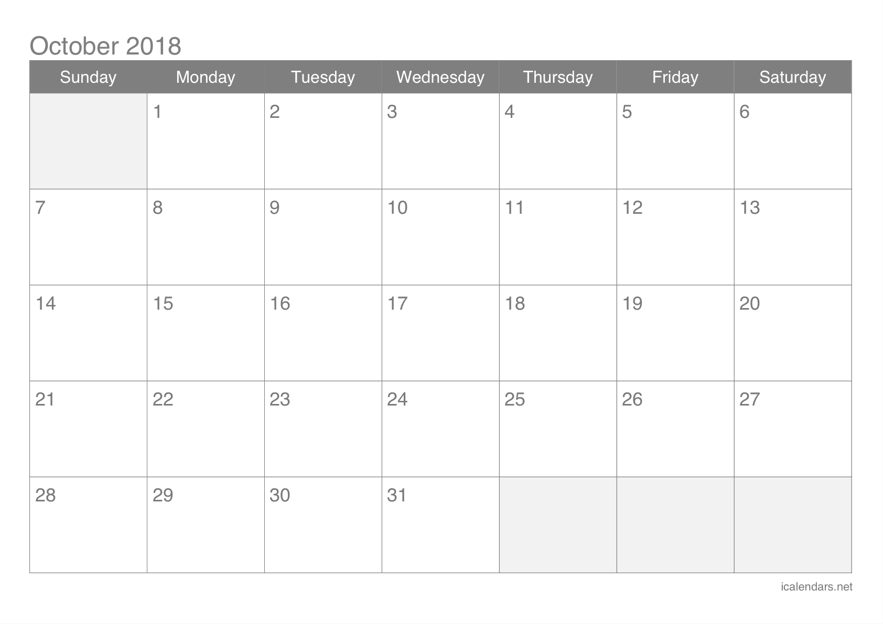
Columbus Day
Grandparents
Sunday
OXI Day Program

Slide 7
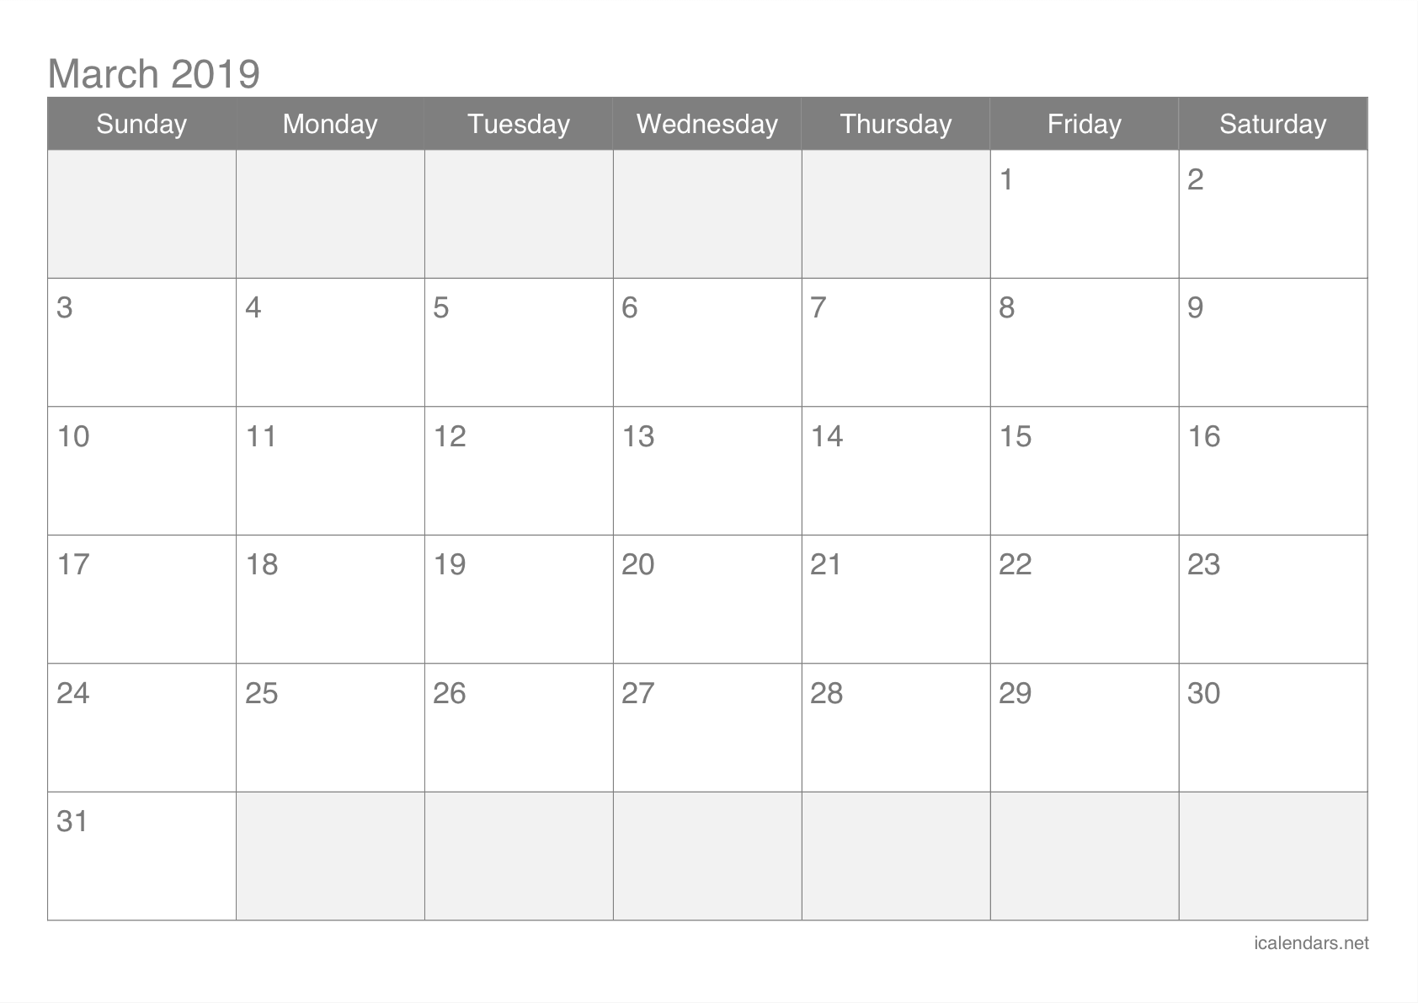
Clean
Monday
Sunday of
Orthodoxy
Greek
Independence
Day Program
Annunciation

