Slide 1
Youth Ministry Planning Meeting
August 2nd 2018

Slide 2
Agenda
Opening Prayer
Calendar Finalization and Approval
Organizational and Program Discussion
Closing Prayer

Slide 3
2 Rid yourselves, therefore, of all malice, and all guile,
insincerity, envy, and all slander. ² Like newborn infants,
long for the pure, spiritual milk, so that by it you may grow
into salvation— ³ if indeed you have tasted that the Lord
is good.⁴ Come to him, a living stone, though rejected
by mortals yet chosen and precious in God’s sight, and
⁵ like living stones, let yourselves be built into a spiritual house,
to be a holy priesthood, to offer spiritual sacrifices acceptable
to God through Jesus Christ.
2 Peter 1:1-5

Slide 4
33

Slide 5
YOUTH MINISTRY MISSION STATEMENT
The mission of our Youth Ministry Programs is to connect, nurture and sustain families through engaging, relevant, and age-appropriate youth and family ministry programming. We accomplish this by learning about our families’ needs, concerns and challenges. We respond to these needs with a strategy that is informed by their participation and our Faith. In this way, our programs integrate our youth and families in to the life of our community and our Faith.
YOUTH MINISTRY VISION STATEMENT
Through effective, vibrant ministry our families will grow to live Christ-centered, healthier, happier, and fulfilling lives.

Slide 6
Proposed Youth Ministry Structure
JOY
HOPE
GOYA
Greek Dance
Mommy and Me
Sunday School
Director
Teachers
Advisors
Advisors
Advisors
Advisors
Advisors
Leadership Committee
Athletics
Coaches
Altar Servers
Altar Captains

Slide 7
Leadership Committee
Clergy
Development
Fundraising
Volunteering
Marketing

Slide 8
Development
Process
Connect
Resources
People
Identify
Opportunities
Areas for Growth
Advance
People
Programming
Roles and Responsibilities
Identify Areas for Growth
Opportunities to build awareness and involvement within church community, metropolis and broader Watertown community.
Connect Ministry Teams with Resources
Speakers, Community Programs, Spiritual Programming, etc.
Advancement of Programs
Work with ministry teams to develop new events, activities, and programming to meet the needs of their participants.

Slide 9
Fundraising
Parish Council
Fundraising
Team
Ministry
Team
Roles and Responsibilities
Works with Ministries to Develop and Set Financial Goals
Develop Fundraising Opportunities for Ministries
Works with PC to manage funds and projects

Slide 10
Volunteering
Organizing Our Community
Talents
Time
Ministries
Development
Roles and Responsibilities
Work with Ministry Teams to Recruit Volunteers
Identify Potential Volunteers (based on skill set, etc.)
Volunteer Management
Safety

Slide 11
Marketing
Example Work Flow
Ministry Team
Content
Schedule
Marketing Team
Receives Information
Prepares for Publication
PC Communication Team
Reviews
Distributes
Roles and Responsibilities
Management of content for newsletter, bulletin, website, social media, etc.
Works to ensure that announcements and information is disseminated accurately and evenly across all platforms.

Slide 12
Proposed Youth Ministry Structure
JOY
HOPE
GOYA
Greek Dance
Mommy and Me
Sunday School
Director
Teachers
Advisors
Advisors
Advisors
Advisors
Advisors
Leadership Committee
Athletics
Coaches
Altar Servers
Altar Captains

Slide 13
Ministry Teams
Roles and Responsibility
Program Direction and Development
Participant Engagement and Development
Monthly Meeting Oversight
Community Engagement

Slide 14
33

Slide 15
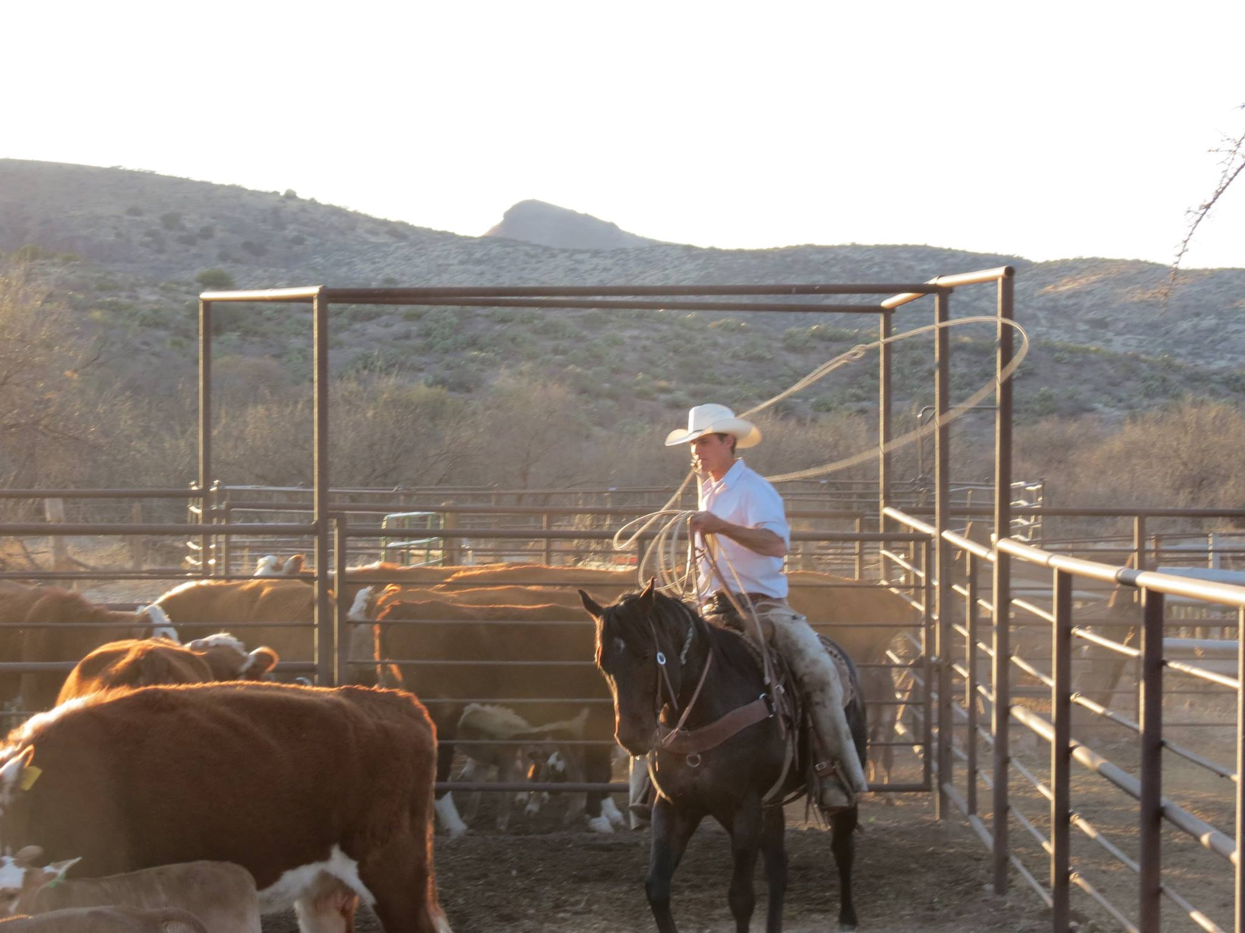

Slide 16
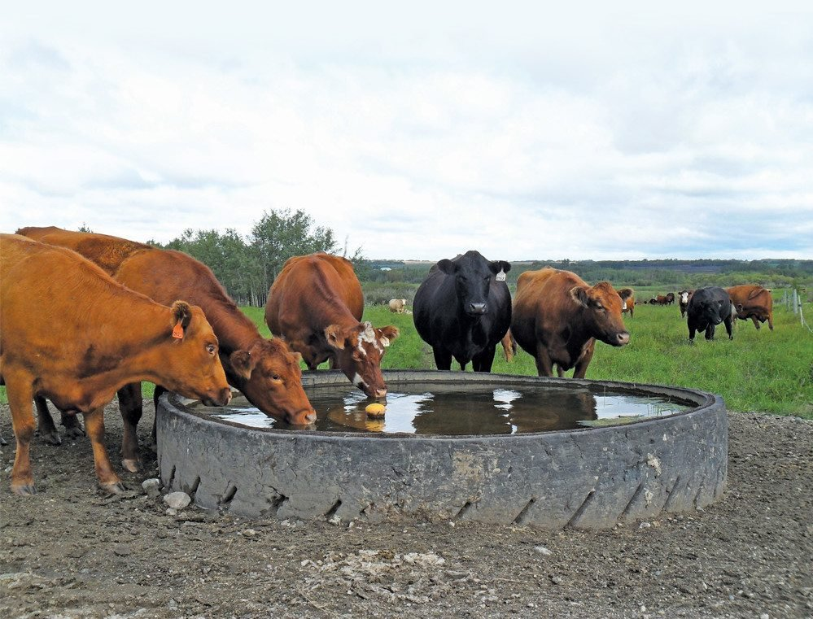

Slide 17
